Slide 1
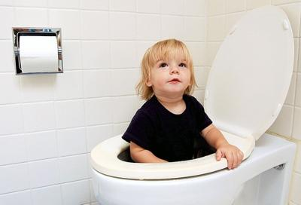
Toilet Training for Parents

Slide 2
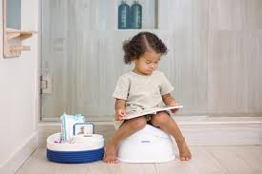
Bear in mind that most children can control their bowels before their bladder.
by age 1, most babies have stopped doing poos at night
by age 2, some children be potty trained, but this is still quite early
by age 3, nine out of ten children are dry most days – even then, all children have the odd accident, especially when they're excited, upset or absorbed in something else
by age 4, most children are reliably dry during the day
It usually takes a little longer for children to learn to stay dry throughout the night. Although most learn this between the ages of 3 and 5, up to 1 in 5 children aged 5 sometimes wet the bed.

Slide 3
Most parents start thinking about potty training when their child is between 2 and 2 and a half, but there's no perfect time. Some people find it easier to start in the summer, when there are fewer clothes to take off and washed clothes dry more quickly.
Try potty training when there are no great disruptions or changes to your child's or your family's routine. It's important to stay consistent, so you don’t confuse your child.

Slide 4
How do you know when to toilet train
There are a number of signs that your child is starting to develop bladder control:
they know when they've got a wet or dirty nappy
they get to know when they're weeing and may tell you they're doing it
the gap between wetting is at least an hour
they show they need to wee by fidgeting or going somewhere quiet or hidden
they know when they need to wee and may say so in advance

Slide 5
Helpful Tips
Let your toddler choose their own potty
Let them choose where they would like their potty to be placed
Let them choose their own pants
If you are going to try the commando method ensure they wear either leggings or cuffed joggers
Get some washable shoes like crocs, so when they do have an accident they can be washed and put back on
Start to read stories about toilet training
A lovely way to incorporate all of these is for parents to go on a special toilet training shopping trip to buy all of the above. Throughout the trip, you should chat excitedly about the new stage in the child’s life.
Try not to use pull ups as they feel just like a nappy

Slide 6
It is common for toddlers to have issues with poo. In terms of physical comfort, it is very important that a child is able to poo (on a potty or a toilet) with their feet resting flat on the ground or a step. Humans are meant to poo while in a squatting position, with feet firmly on the floor. This position allows the muscles around the anus to loosen allowing for the easy passage of poo. For children, sitting on toilets with legs dangling from a toilet seat can cause the anal muscles to tighten making it harder to poo.

Slide 7
Constipation, and related memories and fears, can make many toddlers reluctant to use the toilet. They will often hold in their poo for as long as possible; however, this then leads to even more constipation. Looking at the child’s diet and fluid intake is a good place to start. Many, though, will need to see the GP.
The wonderful story Poo Goes to Pooland really helps young children who are fearful of pooing.

Slide 8
GOLDEN RULE
ONCE YOU START DO NOT STOP
JUST KEEP GOING ALL THEY NEED IS PATIENCE AND TIME

